Slide 1
Outlier Detection
CME 4416 – Introduction to Data Mining

Slide 2

Outline
What is Outlier Detection?
Why Outlier Detection?
Outlier Detection Applications
  Spatial Outlier Detection
  Fraud Detection
  Intrusion Detection
  ...
Outlier Detection Techniques
  Distribution-Based Outlier Detection
  Association Rule Mining
  Bayesian Anomaly Detection
  Outlier Detection with Density Based Clustering
  Distance-Based Outlier Detection

Slide 3
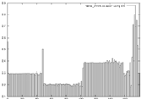
What is Outlier Detection?
Most studies in KDD focus on finding the common patterns.
However, finding the outliers may be more interesting and useful.
Outliers - observations which appear to be inconsistent with the remainder of the dataset.
  Rare Events
  Exceptional Cases
  ...
Outlier Detection is data mining technique like classification, clustering, regression and association rules.
outlier

Slide 4
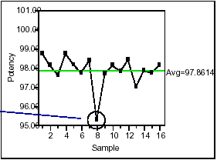
Outlier Example

Slide 5
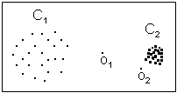
Forms of Outliers
Global Outlier
An observation that deviates so much from other observations.
Local Outlier
Significant deviations from normal behavior.

Slide 6
Forms of Outliers
Extreme Values:
item 5 is an outlier
Non-Extreme Values
item 4 is an outlier
1 | 2 | 3 | 4 | 5 | 6
25 | 25 | 24 | 30 | 188 | 23
1 | 2 | 3 | 4 | 5 | 6
25 | 28 | 31 | 33 | 36 | 39

Slide 7
Outlier Detection Example
Over time, Alice has accessed file F_{n} at rate H_{n}
Recently, Alice has accessed file F_{n} at rate A_{n}
Is this “normal” use?
We compute S = (H₀−A₀)²+(H₁−A₁)²+…+(H₃−A₃)² = .02
And consider S < 0.1 to be normal, so this is normal.
Is this “normal” use?
H₀ | H₁ | H₂ | H₃
.10 | .40 | .40 | .10
A₀ | A₁ | A₂ | A₃
.10 | .40 | .30 | .20
A₀ | A₁ | A₂ | A₃
.10 | .38 | .364 | .156

Slide 8
Why Outlier Detection?
To clean dataset
  A dataset cannot be assumed to be 100% clean
Outliers affect some data mining results
  If your algorithm is sensitive to the outliers, you should remove the outliers (noises) from the dataset before data mining.
Outliers have poor reliability
  Affect outgoing quality
Being indifferent to anomalous behavior is not affordable

Slide 9
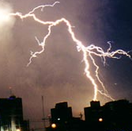







Outlier Detection Applications
Outlier detection can be used in numerous applications:
Spatial outlier detection
Credit card fraud detection
Computer network intrusion detection
Weather anomalies
Video surveillance
Medical analysis
Unusual or unknown astronomical objects
Discovery of criminal activities in e-commerce
Telecom fraud detection

Slide 10
Fraud Detection
Examples:
Auto insurance: detect a group of people who stage accidents to collect on insurance
Money laundering: detect suspicious money transactions
Medical insurance: detect patients, ring of doctors and ring of references
Detecting telephone fraud:
  Telephone call model: destination of the call, duration, time of day or week. Analyze patterns that deviate from an expected norm.
  British Telecom identified discrete groups of callers with frequent intra-group calls, especially mobile phones, and broke a multimillion dollar fraud.
Retail: Analysts estimate that 38% of retail shrink is due to dishonest employees.

Slide 11
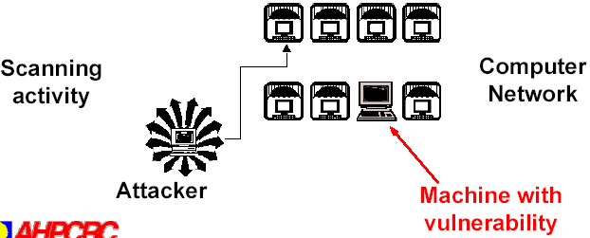
Intrusion Detection
Intrusions are actions aimed to compromise the confidentiality, integrity, and/or availability of a computer or computer network.
Solution: Intrusion Detection Systems
Data Mining and Intrusion Detection: Data mining can help automate the process of investigating intrusion detection alarms.
Behavior-based Anomaly Detection

Slide 12
Intrusion Detection
Discover “attacks / bad behavior” via abnormal behavior
Detecting Behavior
  Data mining has been used to predict behavior
  Modify these techniques to identify anonymous users on a network
  Predict future needs based on past patterns
For Example
  User A typically creates a lot of ssh traffic to a particular server
  User B checks her email and receives large files via FTP after lunch
  User C refreshes the slashdot homepage 10 time per minute for 8 hours

Slide 13
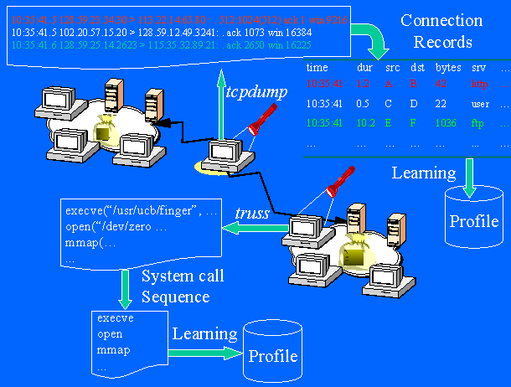
Intrusion Detection Example

Slide 14
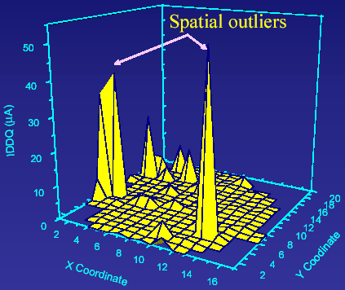
Spatial Outlier Detection
A Spatial Outlier (S-Outlier) is an object whose non-spatial attribute values are significantly different from the values of its spatial neighborhood.

Slide 15
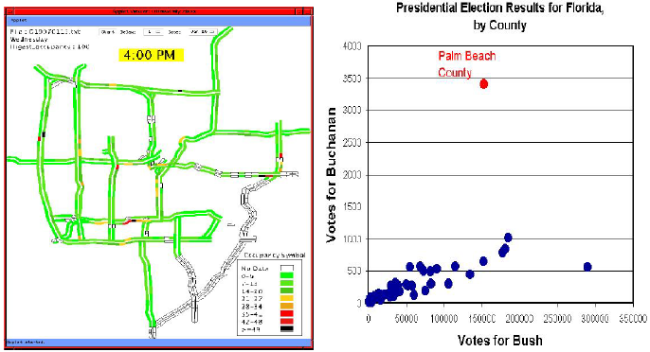
Spatial Outlier Detection

Slide 16
Categories of Outlier Detection Algorithms
Association
Rule
Mining
Bayesian
Anomaly
Detection
Density
Based
Clustering
Distance
Based
DistributionBased

Slide 17

Outlier Detection
1- Distribution-Based
Distribution-Based
  Standard statistical distribution
  (Normal dist., Poisson dist., etc.)
  Data points are modeled using a stochastic distribution
  Outliers are observations which deviate from the given distribution.
Disadvantage
  For many applications, data distribution is unknown.
  The distribution may not fit any of the standard distributions
Start
Distribution Fitting
Standard
Distribution?
No
Detect
DB(p,D)
…
Yes
Normal?
No
Poisson?
…
Yes
Mean and
Variance unknown?
Mean known
Variance unknown?
No
No
…
Yes
Yes
…

Slide 18
Outlier Detection
2- Association Rule Mining
Discovering association rules
Check the rules instantly and detect outliers
Example:
  Process of mining frequent patterns for intrusion detection
  Summarizing attacks using association rules
  {Src IP=206.163.27.95, Dest Port=139, Bytes∈[150, 200)} → {ATTACK}
  For example: If the number of failed login attempts and the network service on the destination are features, result is intrusion detection (outlier):
  num_failed_login_attempts = 6, service = FTP => attack = DoS [1, 0.28 ]
    DoS: Denial of service

Slide 19
Outlier Detection
3- Bayesian Anomaly Detection
Using Bayesian Classification technique to determine Outlier probability
Compare Bayes classification output and current status and determine it is an outlier or not
Start Time | Src IP | Src Port | Dst IP | Dst Port | P | F | Service | Bytes | Attack or Normal
00:00:11.380 | 164.107.1.2 | 1026 | 205.188.2 54.195 | 4000 | 17 | 0 | domain | 56 | ATTACK
00:00:11.384 | 216.65.138.227 | 1055 | 164.10 7.1.3 | 28001 | 17 | 0 | snmptrap | 36 | NORMAL
00:00:11.384 | 164.107.1.3 | 28001 | 216.65.1 38.227 | 1055 | 17 | 0 | N/A | 68 | NORMAL
00:00:11.392 | 164.107.1.4 | 27015 | 24.93.11 5.123 | 1493 | 17 | 0 | http | 1129 | NORMAL
00:00:11.392 | 164.107.1.5 | 1034 | 205.188.2 54.207 | 4000 | 17 | 0 | Ntalk | 48 | ATTACK
00:00:11.392 | 128.146.1.7 | 53 | 206.152.182 .1 | 53 | 17 | 0 | domain | 61 | ATTACK
00:00:11.404 | 204.202.129.230 | 80 | 140.254 .1.6 | 1201 | 6 | 3 | snmptrap | 14719 | NORMAL
.... | .... | .... | ..... | .... | ... | ... | .. | ... | ..

Slide 20
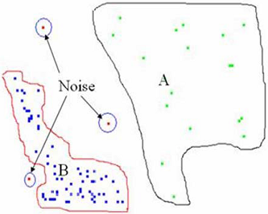
Outlier Detection
4- Density Based Clustering
Clustering-Based
  Outliers are objects not located in any cluster
Clustering Algorithms that can detect outliers
  DBSCAN
  CLIQUE
  CLARANS
  ...
Outlier

Slide 21

Outlier Detection
4- Density Based Clustering
Density-Based
  Determine points at non-dense locations
  Based on the densities of local neighborhoods
  Disadvantage: if tight and loose densities exist
Outlier

Slide 22
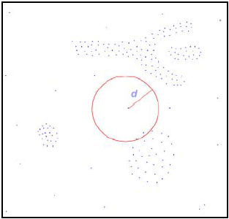
Outlier Detection
5- Distance-Based
Distance-Based
  Use distance metric to measure the distances between the data points
  Define outliers by using the full dimensional distances of the points from one another

Slide 23
Acknowledgement
Asst. Prof. Dr. Derya BİRANT

